Slide 1
Contraception
Dr. Thilina Palihawadana

Slide 2
The concept of family planning
The ability of a couple to plan their family
Prevent ‘unintended pregnancies’
Unintended pregnancy is the main cause of abortions
Estimated to be as high as delivery rate in Sri Lanka
Therefore contraception is a method of life saving

Slide 3
How to avoid a pregnancy
Mechanism | Methods used
Prevention ovulation | COCP, Progestogen injectibles and implants, Oral emergancy contraceptive pills, lactational amenorrhea
Prevent sperm-oocyte interaction | Female sterilization, male sterilization
Prevent implantation | Cu IUCD, LNG-IUS
Impair sperm function | Spermicidal gel
Prevent sperm travel from vagina | Diagphram and cervical cap
Prevent sperm entering the vagina | Male and female condom
Avoid sexuala intercourse | Fertility awareness based methods

Slide 4
Steps in prescribing contraceptives
What does the couple wants to do
What are methods that can be used
What are the methods/couple characteristics
Chose from the available methods
Initiate and follow up

Slide 5
What does couple wants to do
Delay the first child
Space between children
Avoid any further pregnancies
Avoid a pregnancy in an unplanned sexual encounter

Slide 6
What are the methods that can be used?
Medical eligibility criteria by WHO
MEC category | Definition of category
1 | A condition for which there is no restriction for the use of the contraceptive method.
2 | A condition where the advantages of the method generally outweigh the theoretical or proven risks.
3 | A condition where the theoretical or proven risks generally outweigh the advantages of using method. The provision of method requires expert clinical judgement and/or referral to a specialist contraceptive provider, since use of the method is not usually recommended unless other more appropriate methods are not available or not acceptable.
4 | A condition which represents an unacceptable risk from using the contraceptive methods

Slide 7
What are the methods that can be used?
Medical eligibility criteria by WHO
Methods for administration of contraceptives in different settings
Should be anle to provide some contractive method for all
Risk of contraceptive vs. Risk of pregnancy

Slide 8
What are the method/ couple characteristics?
Method
Couple
Failure rate
Reversibility
SE profile
Other benefits
Cost
Social and cultural
Compliance
Acceptibility
Other medication
Breast feeding

Slide 9
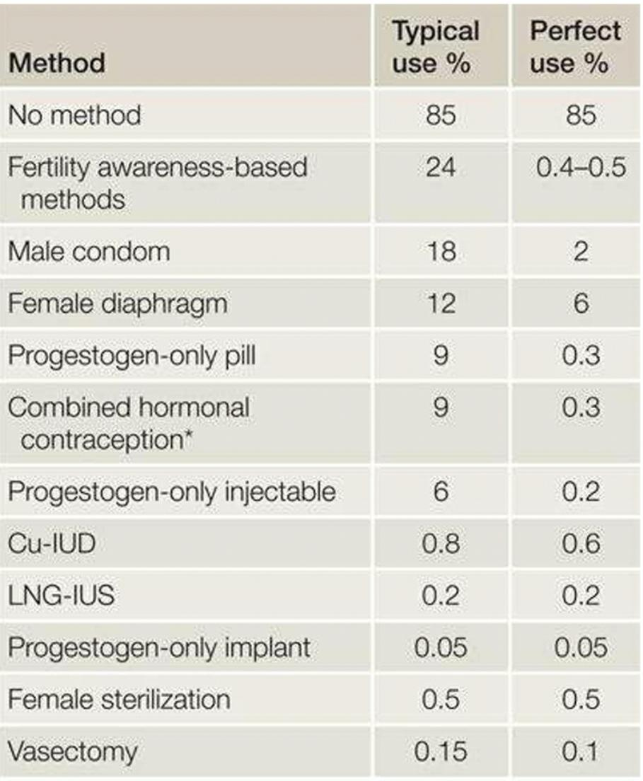
Efficacy and effectiveness
Failure rate
Pearl index
Pregnancies in 100 women for 1 year
Method failure vs. User failure
LARCs- Injectables, implants, IUCDs
Less compliance required
High continuation rate
Minimal gap between failure rate

Slide 10
Reversibility
Relevant in women wishing to delàh the first child and space betweenchildren
Injectable have poor reversibility
Barrier methods, implants and IUCD have high reversibility

Slide 11
Side effect profile
For each method
Mainly a concern with hormonal methods and IUCD devices
Common complaints
Abnormalities in uterine bleeding
Weight gain
Headache
Mood swings
Loss of libido

Slide 12
Non-contraceptive benefits
Method | Benefit against
LNG-IUS (52 mg) | Heavy menstrual bleeding Endometriosis Adenomyosis Dysmenorrhea Endometrial protection Simple hyperplasia
Combined hormonal contraception | Heavy menstrual bleeding Irregular menses Hirsutism Acne Premeñstrual syndrome Reduces risk of ovarian cancer Reduces risk of endometrial cancer
Progestogen only injectable (depot medroxyprogesterone acetate ) | Heavy menstrual bleeding Endometriosis Dysmenorrhea
Non-contraceptive benefits may change the risk-the benefit ratio
Also may change acceptability
Barrier methods-STIs

Slide 13
Compliance
Depend on the requirement and the client characteristics
Route of administration
Frequency of interventions
Instructions and education
Accessibility
Follow up requirement
Main reason for contractive failure

Slide 14
Acceptability
Determinants of contraceptive method acceptability
Personal characteristics (e.g. age) Fertility intention Perceptons of effectiveness Perceptions of safety Fear of side effects Familiarity Experience of others Ease of use and of access Need to see health professional Intrusiveness Non-contraceptive benefits
Directly linked to continuation
Education play a key role
Client autonomy should be respect

Slide 15
When prescribing contraceptives
Non - judgmental
Client autonomy
Select the most suitable method that is acceptable
Discuss the following
How to use-also what to do in deviations
Reversibility
Common side effects and other benefits
Drug interactions
Review and follow up

Slide 16
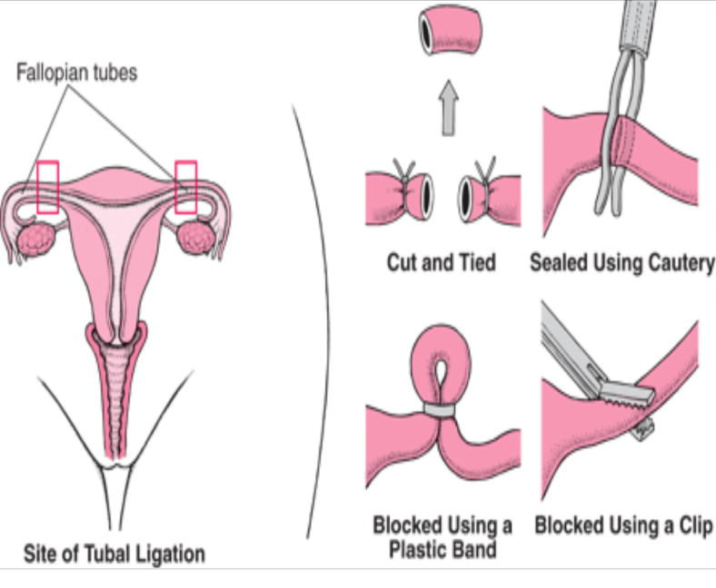
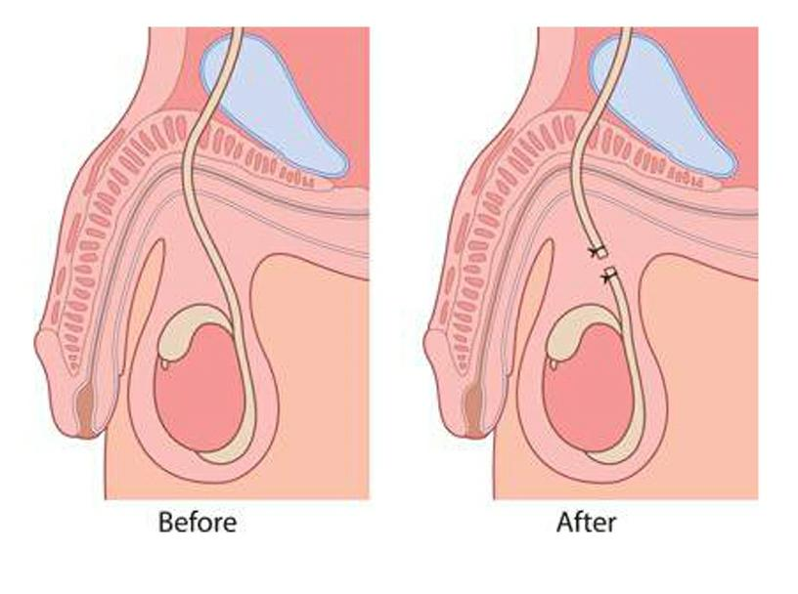
Sterilization
Proper consent should be obtained from the client
Following should be discussed
The irreversible nature
Failure rate- F1:200 – 1:500, M1:2000
Alternatives- LARCs, vasectomy vs female sterilization
Chance of regret- higher with <30yrs, postpartum
Time to be effective
Risk of ectopic in female sterilization
Low success at reversibility

Slide 17
Non-pharmacological methods (FAB)
Still used by some due to religious and cultural reasons
Do not advocate but should be able to advice
Principle- Estimate the time of ovulation and avoid intercourse
Calander method
Six cycles -> (shortest cycle-20d) to (longest cycle-10d)
Cervical mucous
LH testing

Slide 18
Post-coital contraception
Cu IUCD has the lowest failure rate 1:1000
Can be used up to 5 days of coitus
Prevent implanhtation
Oral methods
levenogastrel- 1.5mg – up to 96 hours
PRM- Ulipristal acetate 30mg – up to 120 hours
Delay ovulation

